Slide 1






ASTRASYNC – AI-Synchronized Satellite Geolocation
TEAM NAME : Biospark
Priyadharshini. K
192519090
Mohammad HUSSAIN
192524179
Athin Siva. S
192524237
Yuva sri .P
192519063
Kaviya. R
192519089
Janani D
192519036

Slide 2
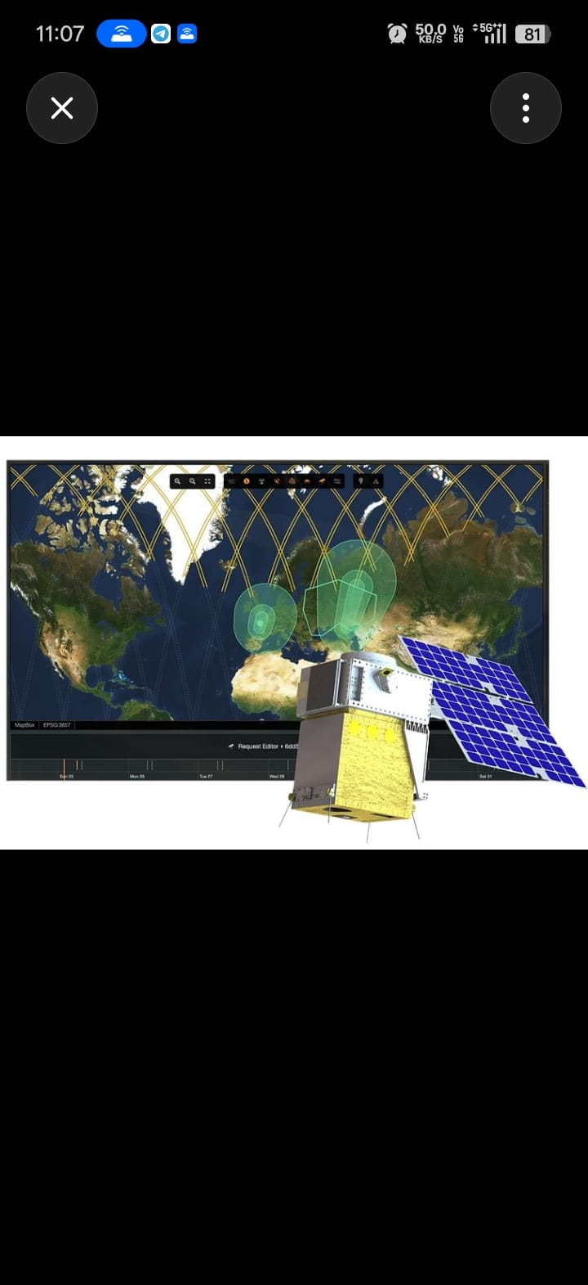
Biospark
ASTRASYNC – AI-Synchronized Satellite Geolocation
Problem Accurate satellite synchronization required Signal interference & Doppler effects High computational complexity Large IQ data processing
Proposed Solution Multi-LEO satellite IQ data collection Joint TDOA + FDOA localization AI-based synchronization correction GIS-based emitter location mapping
Innovation AI + Signal Processing integration High-accuracy, fast localization Cost-effective software prototype

Slide 3
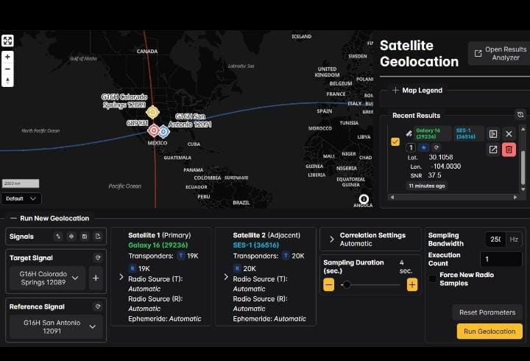
Biospark
Technical Approach
📡 Terrestrial RF Emitter ↓ 🛰️ LEO Satellite Constellation ↓ 📶 IQ Signal Collection ↓ 🌍 Ground Control Station ↓ ⚙️ TDOA + FDOA Processing ↓ 🤖 AI-Based Error Correction ↓ 📍 RF Emitter Geolocation ↓ 🗺️ GIS-Based Location Display

Slide 4

Biospark
Feasibility
Software-based prototype MATLAB & Python implementation Multi-LEO satellite simulation Cost-effective and scalable
Challenges
Satellite time synchronization Doppler shift estimation Large IQ data processing Signal interference
Solutions
AI-based synchronization Joint TDOA + FDOA localization Adaptive noise filtering Optimized parallel processing

Slide 5
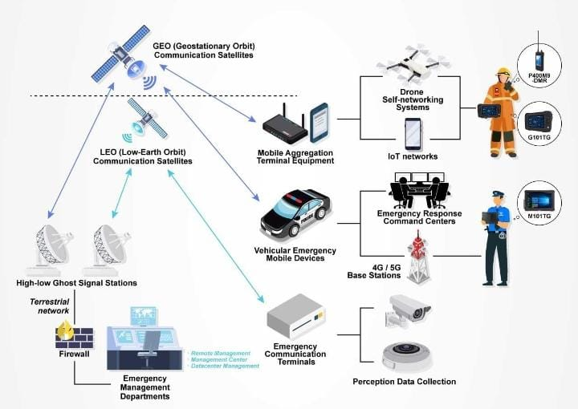
Biospark
Impact
Enhanced national security
Improved border surveillance
Real-time RF emitter tracking
Better situational awareness
Benefits
High geolocation accuracy
Faster threat detection
Cost-effective software solution
Scalable for future LEO constellations
Supports defence & disaster management

Slide 6
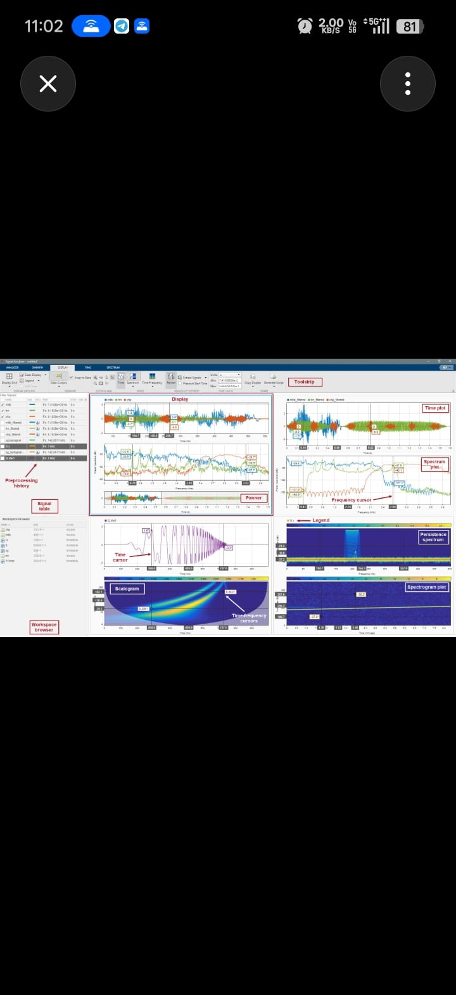
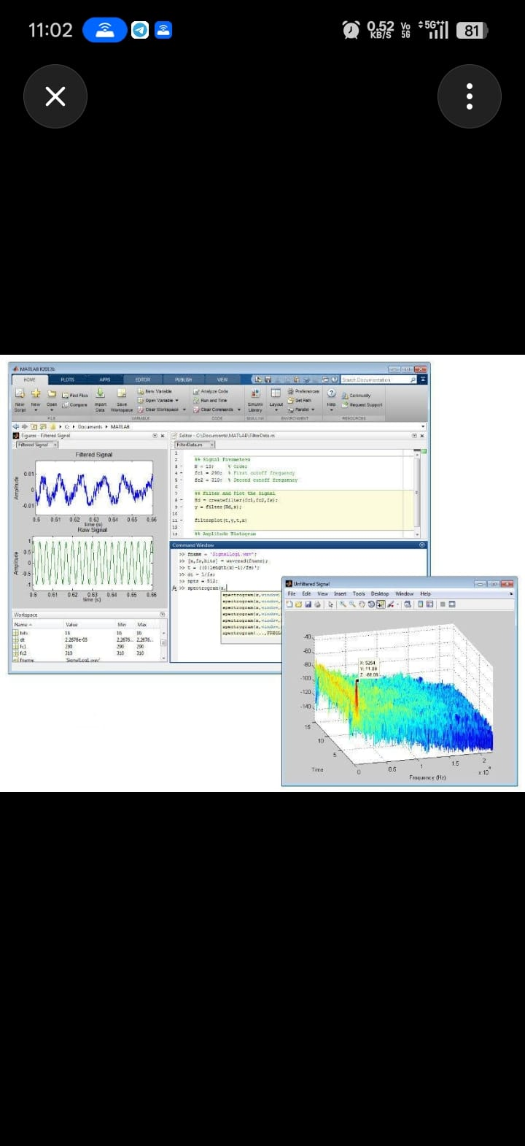
Biospark
Research
Conducted research on LEO satellite communication, TDOA/FDOA-based RF geolocation, and AI-assisted signal processing to improve the accurate detection and localization of terrestrial radio emitters.
References
collected from IEEE, NASA, ESA, MATLAB Documentation, and publicly available research on RF geolocation and LEO satellite systems

